Slide 1
UGO’S TOUCH OF LIFE FOUNDATION (U-ToLF)
SELECTED INDIGENT WOMEN FOR THE WOMEN EMPOWERMENT SCHEME (WES) AT UDENU L.G.A. ENUGU.

Slide 2
MBAH IJEOMA OHOM ORBA
Ijeoma is a 25 year old woman who has four children. She lives in a mud house with her family. Her first child is about 12 years old while the last one is only a month old. Her husband is a wheel barrow pusher with unstable income but earns less than #5000 per month. 2 of her children are in primary school while one is in nursery school. Due to lack of money, she finds it difficult to buy what she needs for the upkeep of her baby.
She used to buy melon (egusi) in cups, peels them with hands and sells at Oye market on Oye market days. Her average income per month used to be #1400 but now she depends solely on whatever her husband brings home or stipends from people to survive because she put to birth about a month ago and has not started working since then.
Preferred empowerment… Goat rearing

Slide 3
ODOH EUCHARIA IMILIKE-UNO
She is in her early forties. She was sent out from her home by her husband because of her childlessness.
She lives with her mother and her disabled sister.
She strives to support her family from menial jobs and processes small food when she finds the money.
Her sister became crippled at the age of 7 and since then has not been able to continue her education.
They cannot afford 3 meals a day.
Desired empowerment: poultry farming and a wheel chair for the disabled sister.

Slide 4
ONUH JOY IGUGU
She is a married woman in her mid thirties. She is with five children who are aged between 10-23 years. Some of the children have been taken to serve as helps in people’s homes and stores.
For a living, she usually clears grass at the village Health Centre for a wage of 3,000 naira a month and other menial jobs for people when possible. Her husband is a carpenter in the village but does not make enough to cater to the basic needs in the home. On some days, they feed just once a day, on some other days, they go without food.
If empowered, she will like to engage in poultry farming

Slide 5
AGBO CHINONSO JUDITH OBOLLO-EKE
Mrs Chinonso is a young widow of 26 years, with a child of 5 years.
She lives with her mother who is a petty trader.
She buys recharge cards on credit and sells for livelihood.
She is quite young and as such is vulnerable and can easily be exploited because of her situation.
Possible empowerment is catering.

Slide 6
MRS. THERESA ASOGWA IGUDU
Mrs. Theresa Asogwa is a widow with seven (7) children aged 6- 18 years. Since the death of her husband, she caters for the whole family, however, 2 of her children are serving in people’s households.
She has few goats she rears, and also processes palm oil. She makes roughly 4,500 naira from these. This income unfortunately is not enough to sustain them and hence most days they feed once or twice a day. One of the children is out of school because of lack of funds.
Before her husband passed, she sold food ukpaka- cooked oil beans.
She would like to continue selling oil beans (Ukpaka), if empowered.

Slide 7
ODOH JOSEPHINE OHOM-ORBA
Josephine is married with 6 children. The oldest child is 18 years while the last is 10 months old.
She makes and sells popcorns in the local market. She gave out three of her children as house helps due to financial hardship.
Her husband is a casual labourer who makes between 500-1,000 naira a month.
Desired Empowerment: local poultry farming

Slide 8
ONAH ALICE OHOM-ORBA
Alice is in her mid-thirties. She is married with 8 children. Her last child is 5 years old.
She processes groundnut and goes all the way to sell it in Nsukka town. Her husband engages in Tobacco processing (Utaba).
Her income together with that of her husband can barely take care of their family needs.
Her desired empowerment would be to expand her business of groundnut processing or local poultry farming

Slide 9
MBAH GLORIA OHOM-ORBA
She is a 40 year old widow who has 3 children. Two of them are living with people as house helps now, while she lives with the last one (who is still in primary school) in a mud house. They find it very difficult to eat up to 2 times a day.
She does menial jobs like weeding people’s farms and equally works as a hired hand in processing local seasoning (okpei) for people who buy them in large quantity from which she generates about #4200 per month.
Desired empowerment…Goat rearing

Slide 10
NNAMANI NKECHI OHOM-ORBA
Nkechi is a married woman in her thirties. She has 3 children aged between 5 years and 19 years.
They were displaced by Boko Haram militants in the North. She resorted to sewing bags at 30 naira per 12 bags. This work eventually affected her waist since she is pregnant.
At present, she is doing nothing. Her husband engages in table trade.
Her desired means of empowerment is table trade

Slide 11
MRS. ANEKE CECILIA IGUGU, UDENU LGA
Mrs Aneke Cecilia is a widow with six (6) children aged between 6-15 years. Ever since her husband died, to tend to her family has been very difficult. Out of her 6 children, only 2 of them are in school. This is due to lack of funds to send others to school.
To take care of her family, she sells cashew nuts occasionally when she can afford to buy from the retailers. She makes about 3,000 naira from this on a monthly basis.
This amount barely caters to their basic needs so she depends mostly on credit purchase.
if empowered, she will like to engage in poultry family.

Slide 12
NNAMANI CHIGOZIE IMILIKE-UNO
Chigozie is a 26 year old widow who has 4 children. All her children are in primary school and she takes care of them alone. They live in a rented apartment. They are unable to eat 3 times a day.
She does menial jobs like weeding people’s farms and equally works as a hired hand in processing local seasoning (okpei) for people who buy them in large quantity from which she generates about #4200 per month.
Desired form of empowerment…sheep rearing

Slide 13
EZE CECILIA OHOM ORBA
Eze Cecilia is a widow . She is about 45 years and childless. Her only child is late but she adopted a boy of 2 years, who she takes care of with the boy’s biological mother (a 19 year old single mother).
She is a fruit seller and has nobody to assist her.
Desired empowerment is fruit trading

Slide 14
EZEME ANN OBOLLO-EKE
She is a widow with 4 children. She learnt how to sew clothes but has been a housewife and a farmer until the death of her husband in March, 2016 (2 months ago).
She has withdrawn her first son from the boarding house and will enrol him in community public school next term after the completion of Junior Exam. Her other children are already in the community public school.
Occasionally, she gets customers to make clothes for but this is not enough to take care of the family’s needs.
If empowered, she will like to expand her tailoring business

Slide 15
MRS EZEONU EUGENIA OBOLLO-EKE
She is a widow in her mid thirties with 4 children. Her kids are aged between 4-11 years.
When she has some cash, she buys Okpa and processes into flour. From the sale of this Okpa flour, she sends her children to school and takes care of their household needs.
Feeding on most days for her family occurs just once a day. Most times, she buys things on credit.
Desired empowerment is Trade, specifically on food stuff

Slide 16
AGBOEZE JULIET CHIOMA IMILIKE-UNO
Juliet is a 41 year old woman who has 5 children. The first is about 14 years old while the last is about 5 years old. She lives in a rented apartment with her family since they do not have a building of their own. She used to buy melon in bags and sell but could not continue after robbers came to her house and stole all the money she had (both hers and other peoples’) which she would have gone to market with the following day. Till this day, she still owes as a result of the robbery incident.
She is currently doing menial jobs like weeding people’s farms and equally works as a hired hand in processing local seasoning (okpei) for people who buy them in large quantity from which she generates about #4000 per month.
Desired empowerment…Goat rearing

Slide 17
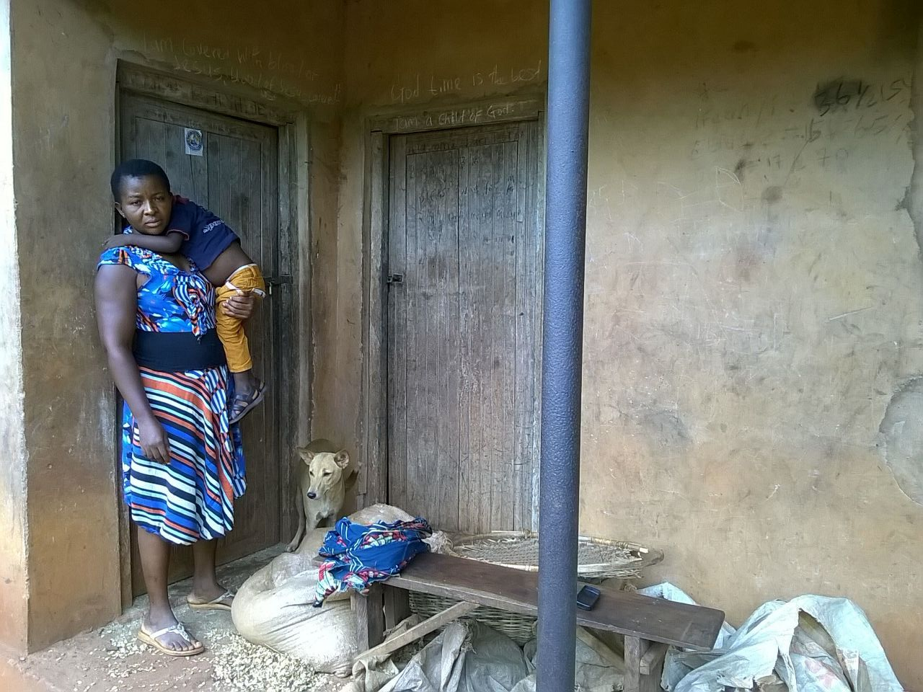
EZEUGWU CELINA OHOM-ORBA
She is married with three children and is in her forties.
She has been into local poultry farming until she had financial challenges. Her husband stays in Awka and works as a farmer. The husband brings little or nothing on his return, hence they strive to keep the family moving and end up starving on some days.
Desired empowerment: local poultry farming

Slide 18
ODOH UCHE ANASTASIA OBOLLO-EKE
Anastasia is married with four children, aged between 9 months to 7 years. She is just 25 years of age. Three of her children are currently in Nursery school.
Her husband is a farmer and she also cultivates cassava. Sometimes, they sell some of their produce to earn a living. To make up, they borrow.
Feeding for the family is usually difficult. On some days, they feed once a day.
If empowered, she would like to trade in processed cassava

Slide 19
UGWU COLLETTE OBOLLO-EKE
Collette is married with 3 children who are aged between 1-5 years. Her husband is a local okada rider and sometimes hunts. However they live with her in-laws who marginalise them since they are the poorest in the family.
She sells cassava occasionally. Together with her husband’s meagre earnings, they cater to their needs but most times to make ends meet, they depend on loans.
She can engage in poultry farming, if empowered.

Slide 20
ODOH EUCHARIA OBOLLO EKE
Eucharia is a widow with 6 children. She is a petty trader.
She withdrew her eldest son from school to learn a trade due to their level of poverty. One of her children is a domestic servant while others are in the community public school.
she can hardly provide 3 meals a day for the family.
Desired empowerment is local poultry farming.

Slide 21
UGWU CHARITY IMILIKE-UNO
Charity is a 40 year old woman who has 3 children. The first is about 14 years old while the last is about 6 years old. She used to live at Nsukka Urban with her family until her mother-in-law fell sick and she came back to take care of her though she eventually died. While at Nsukka Urban, she was selling condiments for soup but could not continue due to lack of money.
She currently processes raw cassava and sells it any time she is fortunate to lay her hands on them. She earns about #1500 per month.
Desired empowerment…sheep rearing

Slide 22
UGWOKE MARTHA OHOM-ORBA
Martha is a young married woman. She has three (3) children. Her youngest child is 2 years old.
Her husband is a village carpenter. She processes food (ukpaka) and also rears goats. Currently, she has 3 goats. However, due to the long period it takes for a goat to mature enough for sale, they do not have steady income and find it difficult to eat and fend for themselves.
If empowered, she will like to increase the number of her goats and also improve on her oil bean business (ukpaka)

Slide 23
ABONYI EMMANUELLA IMILIKE UNO
Emmanuella is a 30 year old widow who has 5 children. Her first child is about 14 years old while the last one is about 2 years old and they all live in a mud house. Eating 3 times a day is difficult for them. Before her husband’s death, she used to buy cashew in bags and sell but she cannot continue due to lack of money.
Like other community women, Mrs. Emmanuella Abonyi does menial jobs like weeding people’s farms and equally works as a hired hand in processing local seasoning (okpei) for people who buy them in large quantity from which she generates about #4000 per month.
Desired empowerment…sheep rearing

Slide 24
UGWUOKE CLEMENTINA OHOM-ORBA
She is a widow with 3 children. She sews cement bags for someone and is paid 20 naira per bag. Her co-wife and her children are not helping except for a room provided for her to accommodate her children.
Her children are in primary school except for the eldest who is in public secondary school.
Sometimes, they depend on people for feeding.
Desired empowerment is table trade.

Slide 25
EKWUEME UKAMAKA OBOLLO-EKE
Mrs Ukamaka Ekwueme is a widow with 7 children.
She lost her husband a long time ago and has been the only one taking care of her children.
She trades on palm oil and makes an average income of 8,000 naira. Her children are enrolled in the community public school. Even her eldest is still in public primary school. She has been in and out of the school because of no funds.
She can hardly provide 3 meals a day for her children.
If empowered she will like to engage in local poultry farming.

Slide 26
OBETTA CHRISTIANA IMILIKE-UNO
Christiana is a 43 year old widow who has 3 children. She returned to her father’s house after her husband’s death because she does not have enough resources to take care of her children alone. She gave out 2 of her children to people as house helps after their primary school because she cannot afford to let them drop out of school and she cannot afford their school fees either.
She does menial jobs like weeding people’s farms and equally works as a hired hand in processing local seasoning (okpei) for people who buy them in large quantity from which she generates about #2,400 a month.
Desired empowerment…Goat rearing

Slide 27
OGBU FIDELIA IGUGU
Ogbu Fidelia is a mother of 7 children.
She treks to other communities to pick stones for people who in turn pay her 3,000 naira at the end of the month. Her eldest son is in secondary school while the others are in primary school (community public school). However, taking care of school needs is very difficult for her since her husband is just a subsistent farmer.
Desired Empowerment is poultry farming.

Slide 28
UGWU GLORIA IMILIKE-UNO
Gloria is a 42 year old widow who has 4 children. Two of her children are no longer in school due to lack of money. Her sick old mother is equally staying with them and at that is also her responsibility. They cannot afford 3 meals a day.
She processes a local seasoning (okpei) and sells at Oye market every market day which is usually in 4 days. She makes about #8000 from it every month but spends more than that because of her responsibilities.
Desired empowerment…ogbono trade

Slide 29
AGU CHRISTIANA IGUGU
Christiana is a widow in her late 30s. She has 9 children. The ages of her children range from 7 to 22 years.
She trades on fruits to train her children. She is also a farmer.
On some days, they find it difficult to feed.
However, in order to meet up to the demands of the family, she depends on the assistance of people.
Desired empowerment is local poultry farming.

Slide 30
ONAH UZOAMAKA IGUGU
Mrs Uzoamaka is a mother of 4 children.
She trades on local gin. Her business liquidated as a result of trying to save the life of her daughter who was ill but later died.
Currently, she is more or less a housewife. She can only afford to buy local gin of about 300 naira to sell. Her children are in public primary school.
Her husband provides about 5000 naira a month for the family’s upkeep.
Desired empowerment is table trade.

Slide 31
ONAH DORIS IFEOMA OBOLLO-EKE
She is 35 years and is married with 5 children. They are victims of the Boko- haram incidents in the Northern part of the country. Two of her children are out of secondary school but no funds to send them to the University. Others are in primary and secondary schools.
Her husband is a farmer but due to poor vision, does not work so much. She processes and sells cassava to take her care of her family needs.
She will like to engage in trade of food items, if empowered.

Slide 32
NGWU VICTORIA OHOM ORBA
Victoria is a 40 year old divorcee and a mother of one (a girl). They both live in a mud house. Since her separation from her husband, she returned to her father’s house and has been living there with her 10 year old daughter.
She does menial jobs like weeding people’s farms and equally works as a hired hand in processing local seasoning (okpei) for people who buy them in large quantity from which she generates about #3,100 a month.
Possible form of empowerment….local poultry

Slide 33
REMARKS
1. Questionnaire for data gathering developed by Okereke N Okoro
2. Field Operation Team included
a. Loveth Ifeyinwa Ilo; (Team Leader)
b. Chiegeonu Ugwuozor
c. Chinenye Nwachineke
d. Akilo Ugochukwu
* Pictures were taken with smart phones.
* Two communities were not captured in this exercise. They are: UMUNDU and OBOLLO AFOR

